Slide 1

Raspberry PI and AI Stream
ZAS
Academy
Dr. Roohi Banu
Mr. Fakruddin Mohammed

Slide 2
Day 2.
Raspberry PI - AI, ML, DL & RL Introduction
ZAS
Academy
Dr. Roohi Banu
Mr. Fakruddin Mohammed

Slide 3

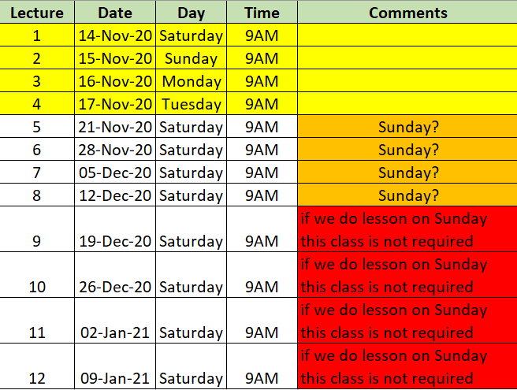

Z A S A C A D E M Y
Raspberry PI - Machine and Deep Learning
(12 Weeks ADVANCED Course for Secondary & College Students)
@78 99 11 222 5
Week1
Week2
Week3
Week4
Week5
Week6
AI Introduction & ML/DL Life Cycle
Data Handling (Pandas & Numpy)
Data Handling & Visualization (matplotlib)
Probability & Statistics (Variable Selection)
Regression
Classification
Course content may be altered depending on participant needs & speed of grasping power
Week7
Week8
Week9
Week10
Week11
Week12
Artificial Neural Networks & Backpropagation
2 Layers Neural Networks & CNN Intuition
Deep Learning CNN & Raspberry PI
Deep Learning CNN & Raspberry PI
Deep Learning CNN & Raspberry PI
Deep Learning CNN & Raspberry PI
Live ZOOM Lectures from 14-Nov:
Natural Language Processing – NLP - ???
At the end of course participants will have
Thorough & deeper understanding of AI/ML/DL (Neural Networks)
Seen full end-to-end life cycle of Data Science Projects
Built at least 1 Deep Learning OBJECT DETECTION model from SCRATCH end-to-end and deploy on to PI

Slide 4

AI Introduction: Machine Learning
https://blogs.nvidia.com/blog/2016/07/29/whats-difference-artificial-intelligence-machine-learning-deep-learning-ai/

Slide 5
AI Introduction: Deep Learning
https://blogs.nvidia.com/blog/2016/07/29/whats-difference-artificial-intelligence-machine-learning-deep-learning-ai/

Slide 6
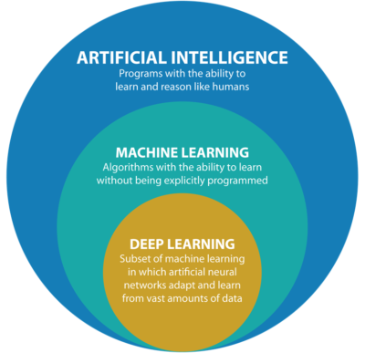
AI Introduction: What is a Deep Learning
Wikipedia Definition
Deep learning is part of a broader family of machine learning methods based on artificial neural networks with representation learning
Deep Learning can be supervised or unsupervised
The adjective "deep" in deep learning comes from the use of multiple layers in the network.
Deep-learning architectures such as deep neural networks, deep belief networks, recurrent neural networks and convolutional neural networks have been applied to fields including
computer vision,
speech recognition,
natural language processing,
audio recognition,
social network filtering,
machine translation,
bioinformatics,
drug design,
medical image analysis,
material inspection and
board game programs,
Deep-learning architectures have produced results comparable to and in some cases surpassing human expert performance
https://blogs.nvidia.com/blog/2016/07/29/whats-difference-artificial-intelligence-machine-learning-deep-learning-ai/

Slide 7
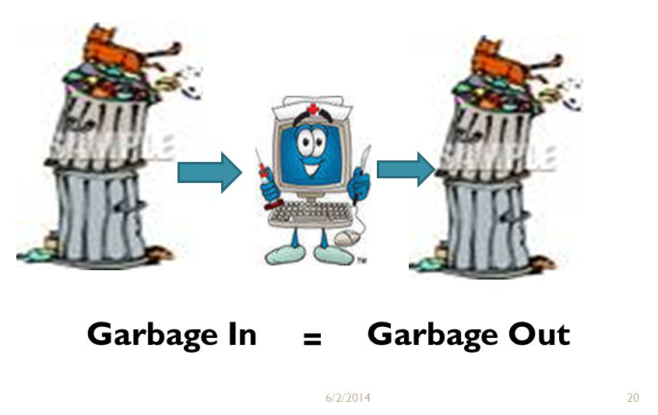
AI Introduction: What is a Happening in Deep Learning
Feature Selection
Recall the Fund Raising Dataset
13 Inputs gave model accuracy of 57.9% and
With 3 Inputs the model accuracy of 57.7%

Slide 8


AI Introduction: What is a Happening in Deep Learning
What do you see in the image?

Slide 9
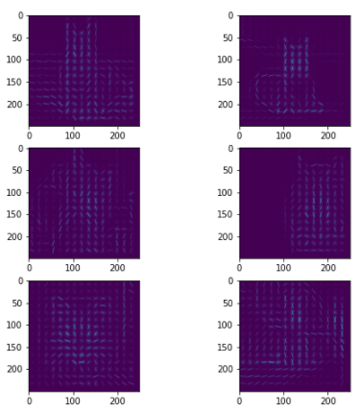
AI Introduction: What is a Happening in Deep Learning
What do you see in the image?

Slide 10
AI Introduction: What is a Happening in Deep Learning
Feature Selection for Images
Edges
Gradients (Magnitude)
Gradient (Magnitude & Direction)

Slide 11
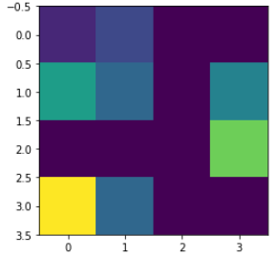
AI Introduction: What is a Happening in Deep Learning
Convolution/Filter/Gradient – Keeping Dimensions Constant
1. Start with simple 4x4 Image and we want to extract the features from this image
1 | 2 | 0 | 0
5 | 3 | 0 | 4
0 | 0 | 0 | 7
9 | 3 | 0 | 0
2. Use a kernel of size 2x2 or 3x3, apply sliding window technique to extract the features.
1 | 1 | 1
1 | 1 | 0
1 | 0 | 0
0 | 0 | 1
0 | 1 | 1
1 | 1 | 1
Flip
left to right &
Upside down

Slide 12
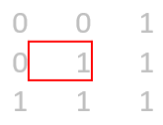
AI Introduction: What is a Happening in Deep Learning
Convolution/Filter/Gradient – Keeping Dimensions Constant
1 | 2 | 0 | 0
5 | 3 | 0 | 4
0 | 0 | 0 | 7
9 | 3 | 0 | 0
1 | 2 | 0 | 0
5 | 3 | 0 | 4
0 | 0 | 0 | 7
9 | 3 | 0 | 0
1 | 2 | 0 | 0
5 | 3 | 0 | 4
0 | 0 | 0 | 7
9 | 3 | 0 | 0
1 | 2 | 0 | 0
5 | 3 | 0 | 4
0 | 0 | 0 | 7
9 | 3 | 0 | 0
1*1 + 2*1 + 5*1 + 3*1 = 11
2*1 + 5*1 + 3*1 = 10
3*1 + 4*1 = 7
4*1 = 4
1st row → [11, 10, 7, 4]

Slide 13
AI Introduction: What is a Happening in Deep Learning
Convolution/Filter/Gradient – Keeping Dimensions Constant
1 | 2 | 0 | 0
5 | 3 | 0 | 4
0 | 0 | 0 | 7
9 | 3 | 0 | 0
1 | 2 | 0 | 0
5 | 3 | 0 | 4
0 | 0 | 0 | 7
9 | 3 | 0 | 0
1 | 2 | 0 | 0
5 | 3 | 0 | 4
0 | 0 | 0 | 7
9 | 3 | 0 | 0
1 | 2 | 0 | 0
5 | 3 | 0 | 4
0 | 0 | 0 | 7
9 | 3 | 0 | 0
2*1 + 5*1 + 3*1 = 10
3*1 = 3
4*1 + 7*1 = 11
4*1 + 7*1 = 11
2nd row → [10, 3, 11, 11]

Slide 14
AI Introduction: What is a Happening in Deep Learning
Convolution/Filter/Gradient – Keeping Dimensions Constant
1 | 2 | 0 | 0
5 | 3 | 0 | 4
0 | 0 | 0 | 7
9 | 3 | 0 | 0
1 | 2 | 0 | 0
5 | 3 | 0 | 4
0 | 0 | 0 | 7
9 | 3 | 0 | 0
1 | 2 | 0 | 0
5 | 3 | 0 | 4
0 | 0 | 0 | 7
9 | 3 | 0 | 0
1 | 2 | 0 | 0
5 | 3 | 0 | 4
0 | 0 | 0 | 7
9 | 3 | 0 | 0
3*1 + 9*1 + 3*1 = 15
9*1 + 3*1 = 12
4*1 + 7*1+3*1 = 14
7*1 = 7
3rd row → [15, 12, 14, 7]

Slide 15
AI Introduction: What is a Happening in Deep Learning
Convolution/Filter/Gradient – Keeping Dimensions Constant
1 | 2 | 0 | 0
5 | 3 | 0 | 4
0 | 0 | 0 | 7
9 | 3 | 0 | 0
1 | 2 | 0 | 0
5 | 3 | 0 | 4
0 | 0 | 0 | 7
9 | 3 | 0 | 0
1 | 2 | 0 | 0
5 | 3 | 0 | 4
0 | 0 | 0 | 7
9 | 3 | 0 | 0
1 | 2 | 0 | 0
5 | 3 | 0 | 4
0 | 0 | 0 | 7
9 | 3 | 0 | 0
9*1 + 3*1 = 12
3*1 = 3
7*1= 7
= 0
4th row → [12, 3, 7, 0]

Slide 16
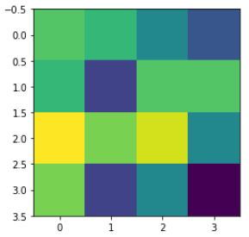
AI Introduction: What is a Happening in Deep Learning
Convolution/Filter/Gradient – Keeping Dimensions Constant
Input Image
1 | 2 | 0 | 0
5 | 3 | 0 | 4
0 | 0 | 0 | 7
9 | 3 | 0 | 0
Feature Map Image
11 | 10 | 7 | 4
10 | 3 | 11 | 11
15 | 12 | 14 | 7
12 | 3 | 7 | 0

Slide 17
AI Introduction: What is a Happening in Deep Learning
Convolution/Filter/Gradient – Reduced Dimensions
1 | 2 | 0 | 0
5 | 3 | 0 | 4
0 | 0 | 0 | 7
9 | 3 | 0 | 0
1 | 2 | 0 | 0
5 | 3 | 0 | 4
0 | 0 | 0 | 7
9 | 3 | 0 | 0
1 | 2 | 0 | 0
5 | 3 | 0 | 4
0 | 0 | 0 | 7
9 | 3 | 0 | 0
3*1 = 3
4*1 + 7*1 = 11
ignore – it crosses the boundary
1st row → [3, 11]

Slide 18
AI Introduction: What is a Happening in Deep Learning
Convolution/Filter/Gradient – Reduced Dimensions
1 | 2 | 0 | 0
5 | 3 | 0 | 4
0 | 0 | 0 | 7
9 | 3 | 0 | 0
1 | 2 | 0 | 0
5 | 3 | 0 | 4
0 | 0 | 0 | 7
9 | 3 | 0 | 0
1 | 2 | 0 | 0
5 | 3 | 0 | 4
0 | 0 | 0 | 7
9 | 3 | 0 | 0
9*1 + 3*1 = 12
4*1 + 7*1 + 3*1 = 14
ignore – it crosses the bounday
2ndrow → [12, 14]

Slide 19
AI Introduction: What is a Happening in Deep Learning
Convolution/Filter/Gradient – Reduced Dimensions
1 | 2 | 0 | 0
5 | 3 | 0 | 4
0 | 0 | 0 | 7
9 | 3 | 0 | 0
1 | 2 | 0 | 0
5 | 3 | 0 | 4
0 | 0 | 0 | 7
9 | 3 | 0 | 0
1 | 2 | 0 | 0
5 | 3 | 0 | 4
0 | 0 | 0 | 7
9 | 3 | 0 | 0
ignore – it crosses the boundary
ignore – it crosses the boundary
ignore – it crosses the boundary
No 3rd row and 4th row

Slide 20
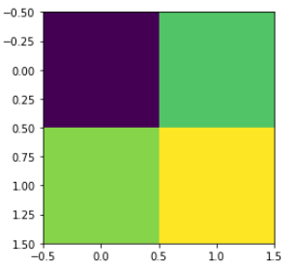
AI Introduction: What is a Happening in Deep Learning
Convolution/Filter/Gradient – Reduced Dimensions
Input Image
1 | 2 | 0 | 0
5 | 3 | 0 | 4
0 | 0 | 0 | 7
9 | 3 | 0 | 0
Feature Map Image
3 | 11
12 | 14

Slide 21
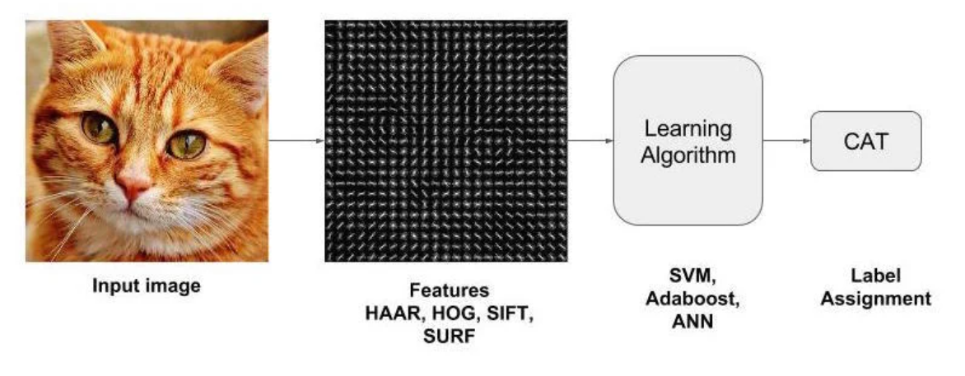
AI Introduction: What is a Happening in Deep Learning
Deep Learning Pipeline (using Computer Vision – without Neural Networks)
https://blogs.nvidia.com/blog/2016/07/29/whats-difference-artificial-intelligence-machine-learning-deep-learning-ai/

Slide 22
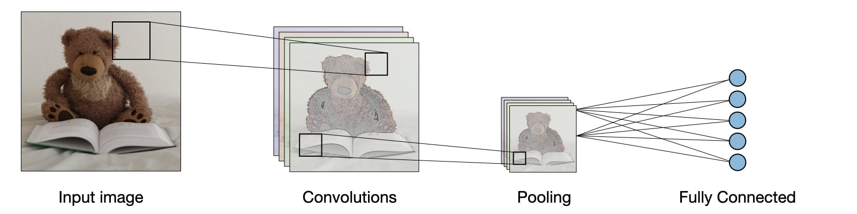
AI Introduction: What is a Happening in Deep Learning
Deep Learning Pipeline (using Neural Networks)
https://blogs.nvidia.com/blog/2016/07/29/whats-difference-artificial-intelligence-machine-learning-deep-learning-ai/

Slide 23

AI Introduction: What is a Happening in Deep Learning
Deep Learning Pipeline (using Neural Networks)
https://blogs.nvidia.com/blog/2016/07/29/whats-difference-artificial-intelligence-machine-learning-deep-learning-ai/

Slide 24

AI Introduction: What is a Happening in Deep Learning
Deep Learning Pipeline (using Neural Networks)
https://blogs.nvidia.com/blog/2016/07/29/whats-difference-artificial-intelligence-machine-learning-deep-learning-ai/

Slide 25
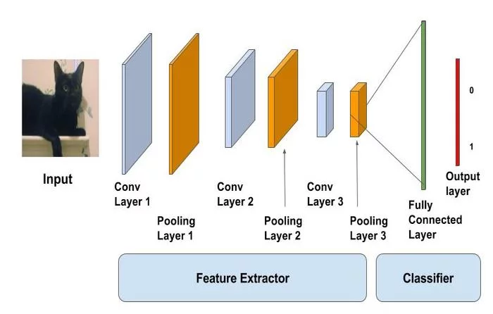
AI Introduction: What is a Happening in Deep Learning
Deep Learning Pipeline (using Neural Networks)
https://blogs.nvidia.com/blog/2016/07/29/whats-difference-artificial-intelligence-machine-learning-deep-learning-ai/

Slide 26
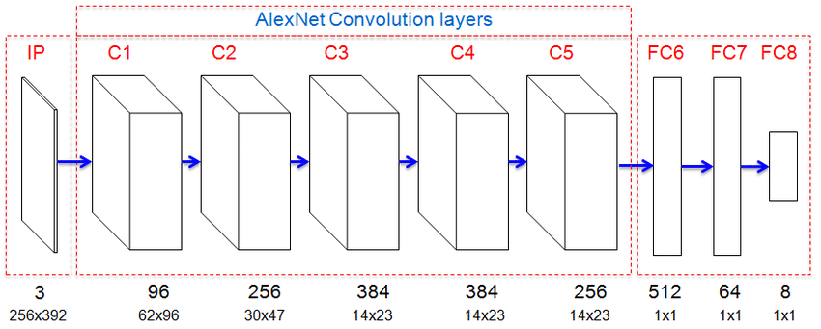
AI Introduction: What is a Happening in Deep Learning
AlexNet – CNN Architecture
https://blogs.nvidia.com/blog/2016/07/29/whats-difference-artificial-intelligence-machine-learning-deep-learning-ai/

Slide 27
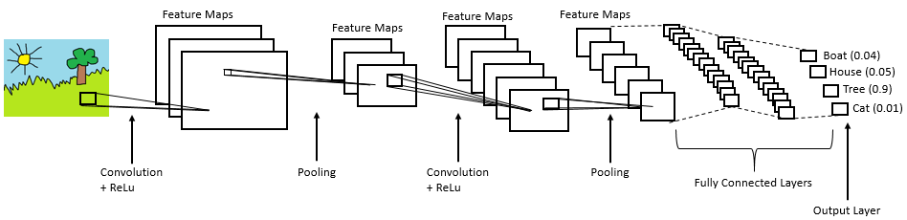
AI Introduction: What is a Happening in Deep Learning
Deep Learning Pipeline (using Neural Networks)
https://blogs.nvidia.com/blog/2016/07/29/whats-difference-artificial-intelligence-machine-learning-deep-learning-ai/

Slide 28
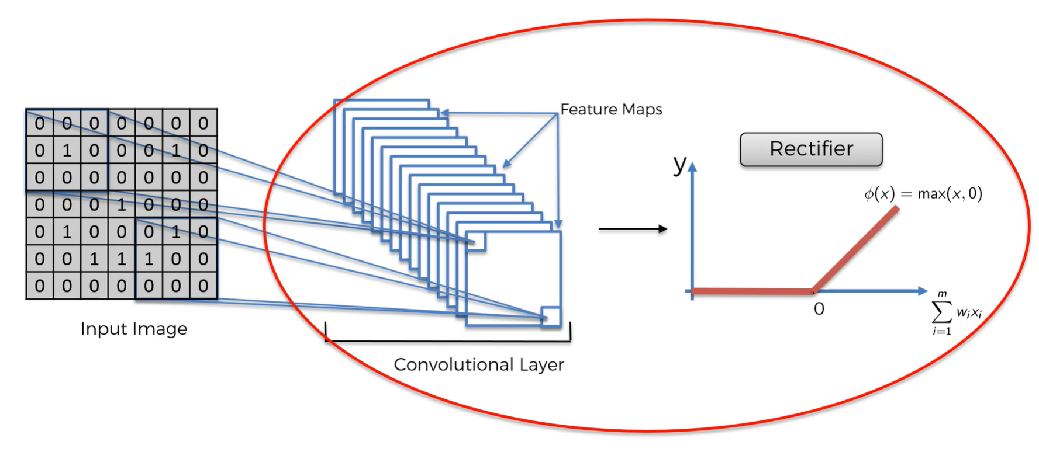
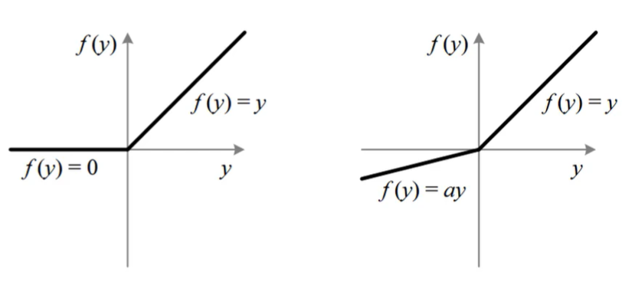
AI Introduction: What is a Happening in Deep Learning
Activation Function: ReLU (Rectified Linear Unit)
https://blogs.nvidia.com/blog/2016/07/29/whats-difference-artificial-intelligence-machine-learning-deep-learning-ai/

Slide 29

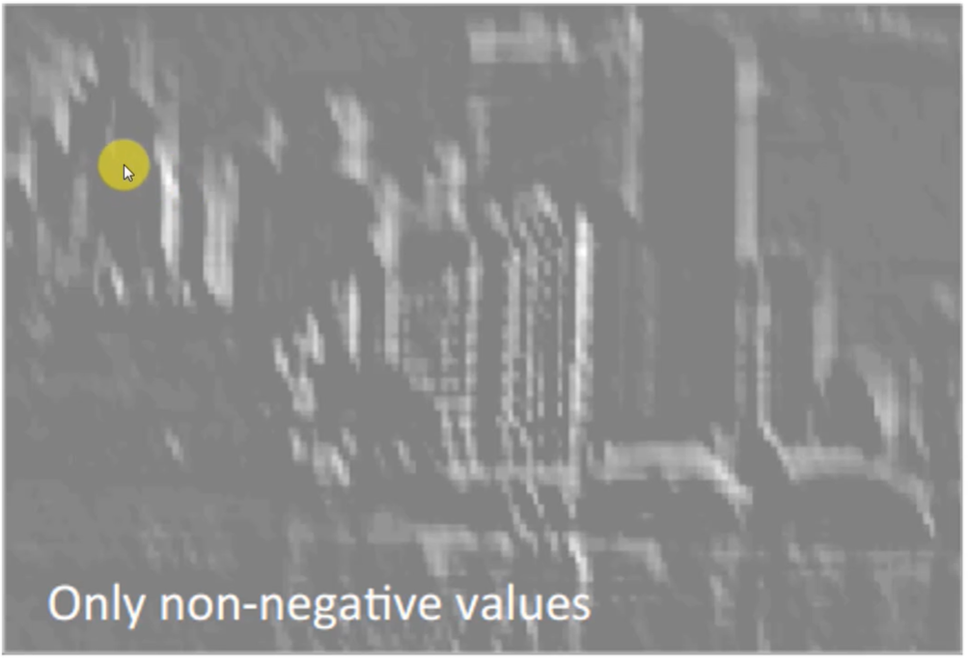
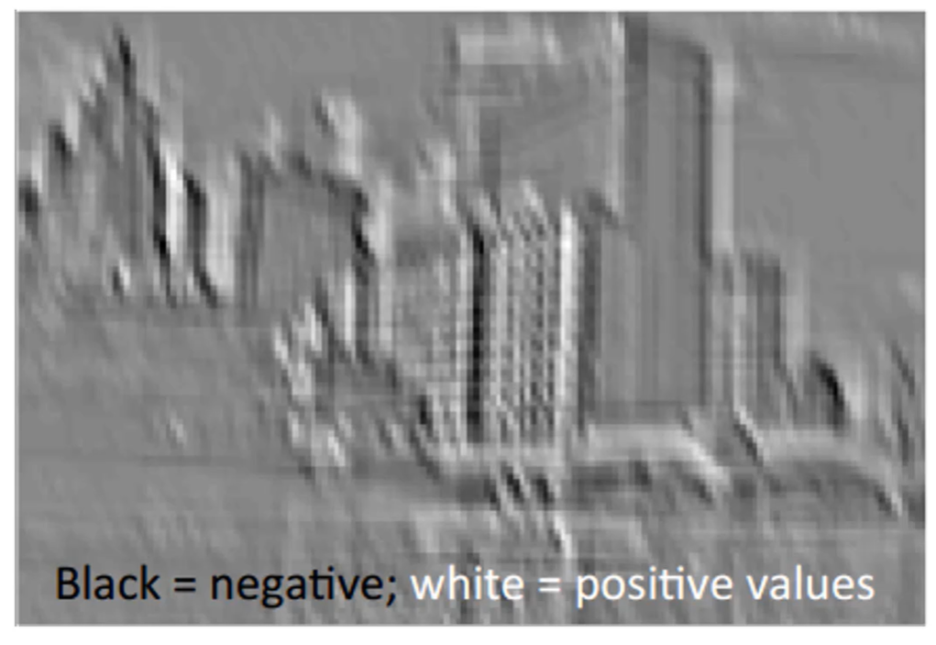
AI Introduction: What is a Happening in Deep Learning
Activation Functions: ReLU (Rectified Linear Unit)
https://blogs.nvidia.com/blog/2016/07/29/whats-difference-artificial-intelligence-machine-learning-deep-learning-ai/

Slide 30
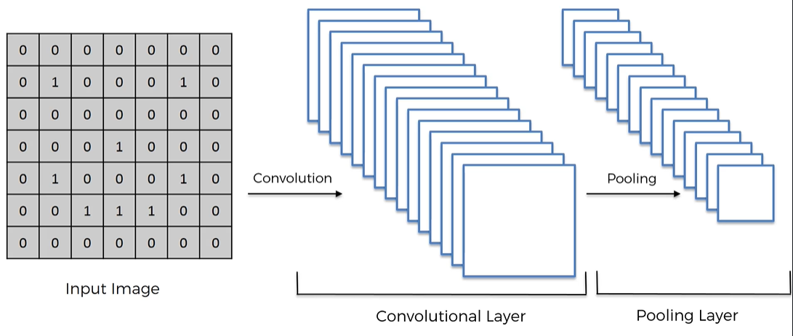
AI Introduction: What is a Happening in Deep Learning
Convolution Architecture
https://blogs.nvidia.com/blog/2016/07/29/whats-difference-artificial-intelligence-machine-learning-deep-learning-ai/

Slide 31
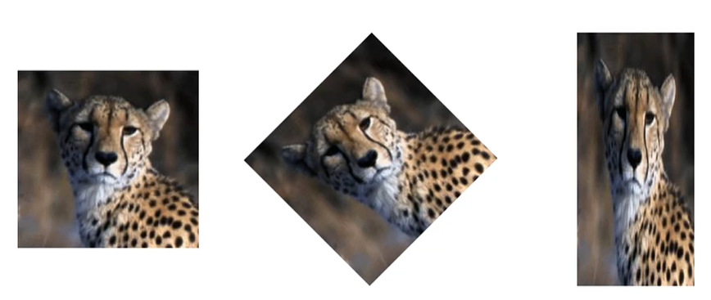

AI Introduction: What is a Happening in Deep Learning
What is Max Pooling?
Max pooling helps in features spatial invariance:
features can be anywhere in the image,
features can be distorted
https://blogs.nvidia.com/blog/2016/07/29/whats-difference-artificial-intelligence-machine-learning-deep-learning-ai/

Slide 32
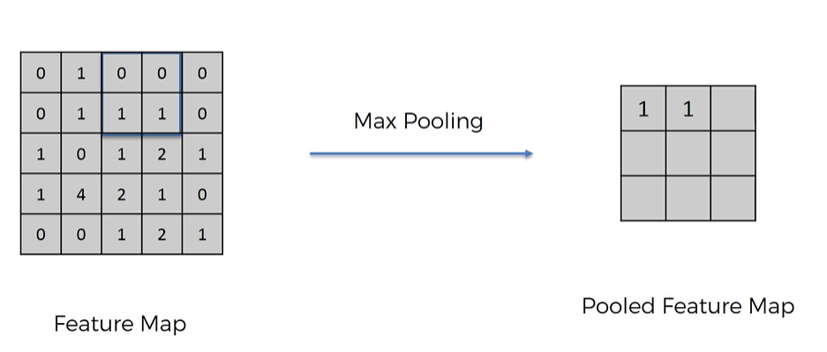
AI Introduction: What is a Happening in Deep Learning
What is Max Pooling?
We apply a filter 2x2 or 4x4 matrix
Then pick the max number
Helps in dimensions reduction (hence number of parameters/weights)
Prevents model overfitting
Imagine the feature 4 represent cheetah tears, the max pooling helps to identify them even if the tears are in different place
https://blogs.nvidia.com/blog/2016/07/29/whats-difference-artificial-intelligence-machine-learning-deep-learning-ai/

Slide 33
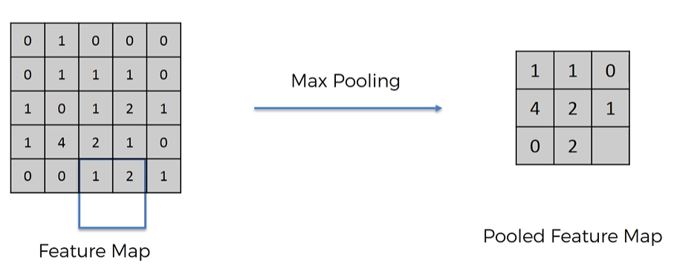
AI Introduction: What is a Happening in Deep Learning
What is Max Pooling?
We apply a filter 2x2 or 4x4 matrix
Then pick the max number
Helps in dimensions reduction (hence number of parameters/weights)
Prevents model overfitting
https://blogs.nvidia.com/blog/2016/07/29/whats-difference-artificial-intelligence-machine-learning-deep-learning-ai/

Slide 34
AI Introduction: What is a Happening in Deep Learning
Different Types of Pooling
Max Pooling
Sum Pooling
Mean pooling
Tanh Pooline
https://blogs.nvidia.com/blog/2016/07/29/whats-difference-artificial-intelligence-machine-learning-deep-learning-ai/

Slide 35
AI Introduction: What is a Happening in Deep Learning
Convolution Architecture - Visualization
https://www.cs.ryerson.ca/~aharley/vis/conv/
https://blogs.nvidia.com/blog/2016/07/29/whats-difference-artificial-intelligence-machine-learning-deep-learning-ai/

Slide 36
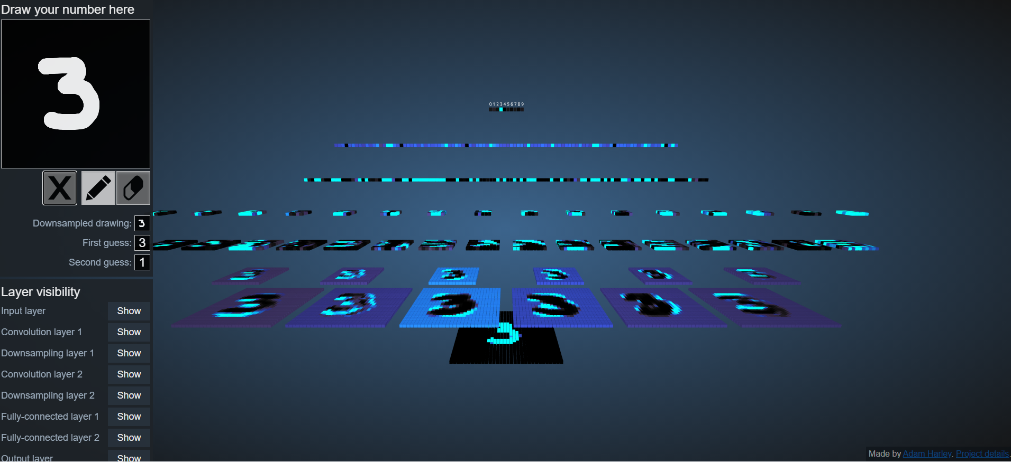
AI Introduction: What is a Happening in Deep Learning
Convolution Architecture - Visualization
https://blogs.nvidia.com/blog/2016/07/29/whats-difference-artificial-intelligence-machine-learning-deep-learning-ai/

Slide 37
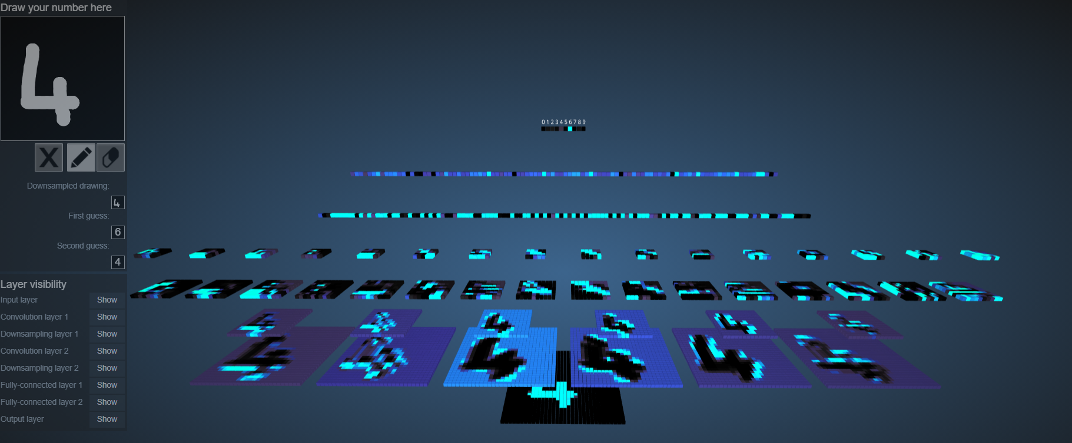
AI Introduction: What is a Happening in Deep Learning
Convolution Architecture - Visualization
https://blogs.nvidia.com/blog/2016/07/29/whats-difference-artificial-intelligence-machine-learning-deep-learning-ai/

Slide 38
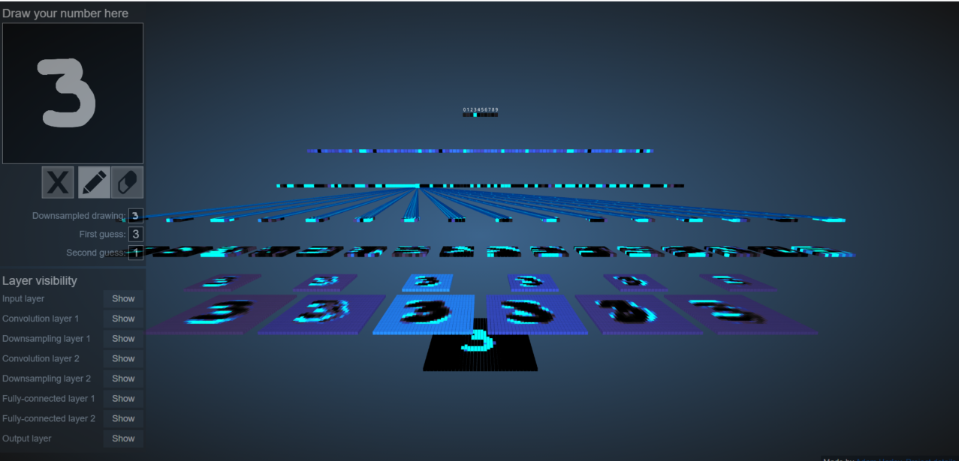
AI Introduction: What is a Happening in Deep Learning
Convolution Architecture - Flattening
flattening
https://blogs.nvidia.com/blog/2016/07/29/whats-difference-artificial-intelligence-machine-learning-deep-learning-ai/

Slide 39
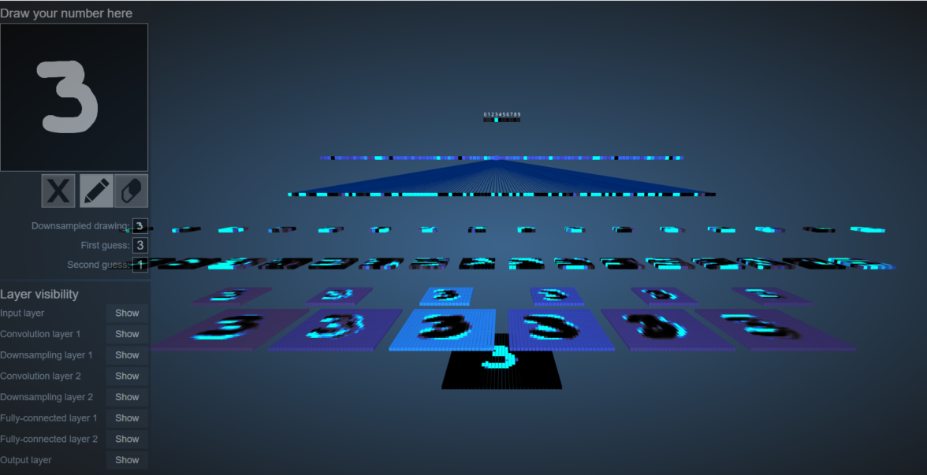
AI Introduction: What is a Happening in Deep Learning
Convolution Architecture - Fully Connected
Fully Connected
https://blogs.nvidia.com/blog/2016/07/29/whats-difference-artificial-intelligence-machine-learning-deep-learning-ai/

Slide 40
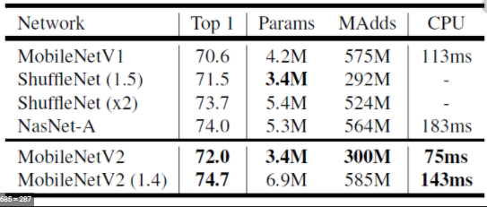
AI Introduction: What is a Happening in Deep Learning
AlexNet – CNN Architecture
https://blogs.nvidia.com/blog/2016/07/29/whats-difference-artificial-intelligence-machine-learning-deep-learning-ai/

Slide 41
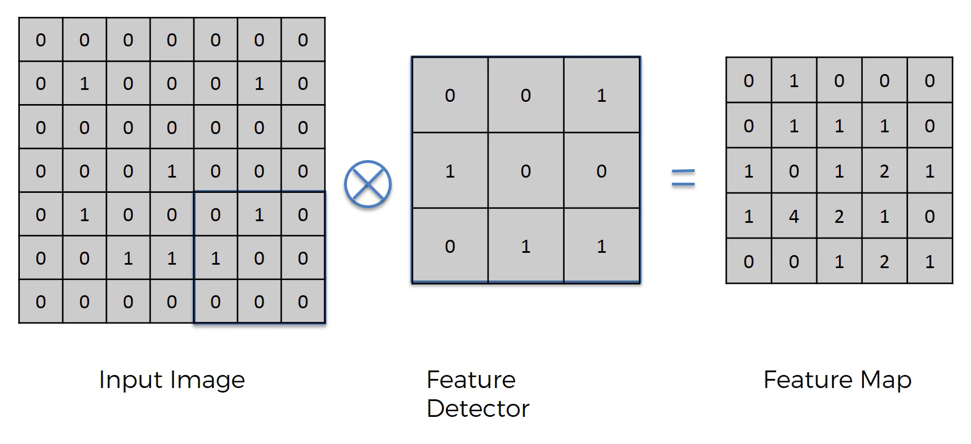
AI Introduction: What is a Happening in Deep Learning
Convolution - Kernels
https://blogs.nvidia.com/blog/2016/07/29/whats-difference-artificial-intelligence-machine-learning-deep-learning-ai/

Slide 42
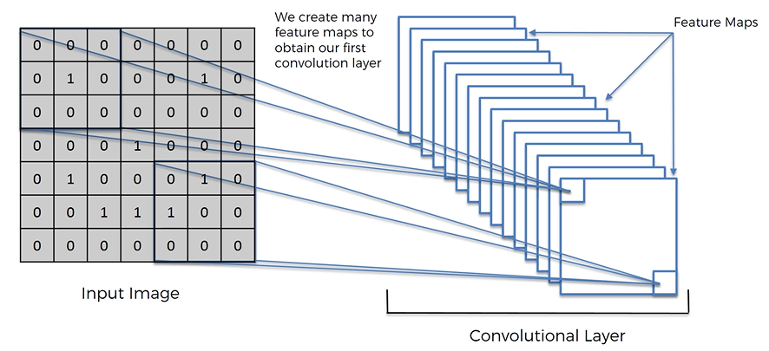
AI Introduction: What is a Happening in Deep Learning
Convolution - Kernels
https://blogs.nvidia.com/blog/2016/07/29/whats-difference-artificial-intelligence-machine-learning-deep-learning-ai/

Slide 43
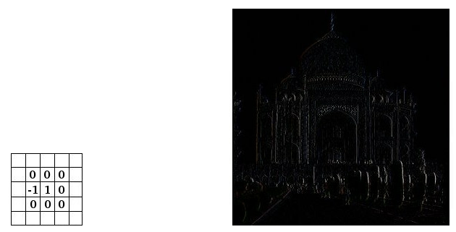
AI Introduction: What is a Happening in Deep Learning
Convolution – Kernels/Feature Detectors
Edge Detection
https://blogs.nvidia.com/blog/2016/07/29/whats-difference-artificial-intelligence-machine-learning-deep-learning-ai/

Slide 44
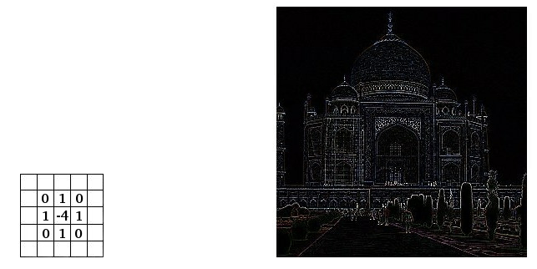
AI Introduction: What is a Happening in Deep Learning
Convolution – Kernels/Feature Detectors
Edge Enhancement
https://blogs.nvidia.com/blog/2016/07/29/whats-difference-artificial-intelligence-machine-learning-deep-learning-ai/

Slide 45
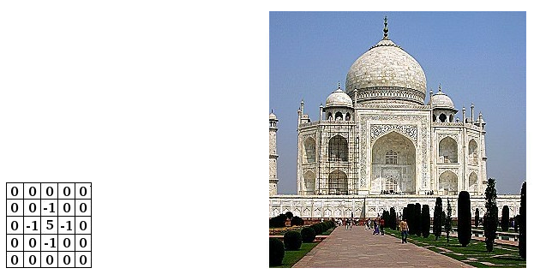
AI Introduction: What is a Happening in Deep Learning
Convolution – Kernels/Feature Detectors
Sharpen
https://blogs.nvidia.com/blog/2016/07/29/whats-difference-artificial-intelligence-machine-learning-deep-learning-ai/

Slide 46
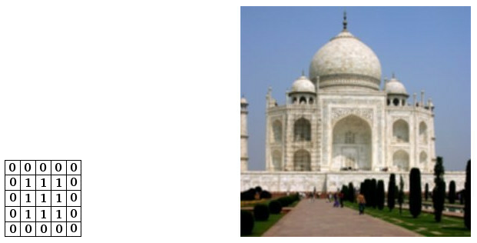
AI Introduction: What is a Happening in Deep Learning
Convolution – Kernels/Feature Detectors
Blur
https://blogs.nvidia.com/blog/2016/07/29/whats-difference-artificial-intelligence-machine-learning-deep-learning-ai/

Slide 47
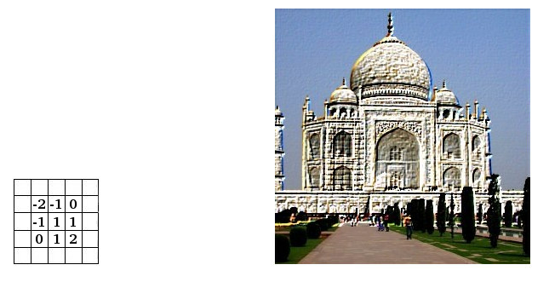
AI Introduction: What is a Happening in Deep Learning
Convolution – Kernels/Feature Detectors
Emboss
https://docs.gimp.org/2.10/en/gimp-filter-convolution-matrix.html

